Slide 1


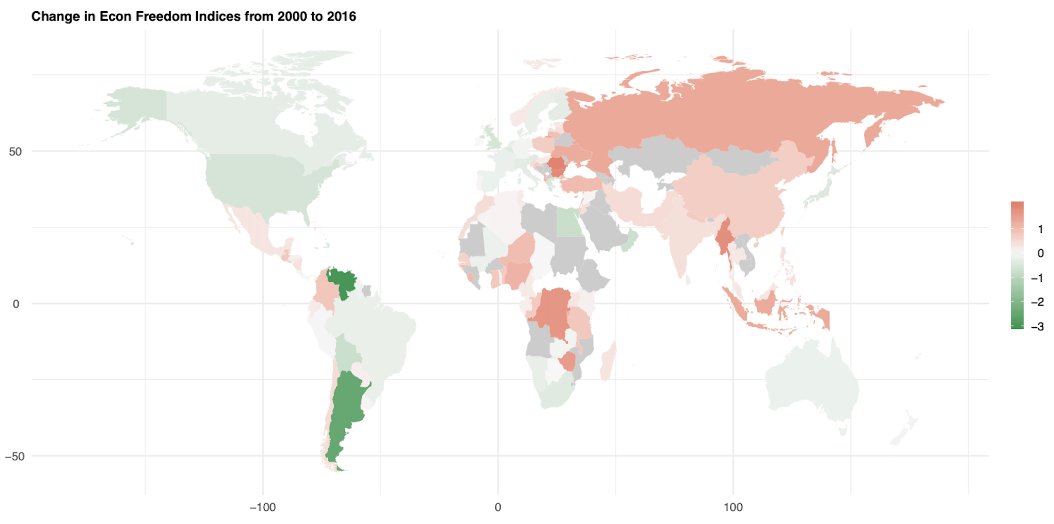
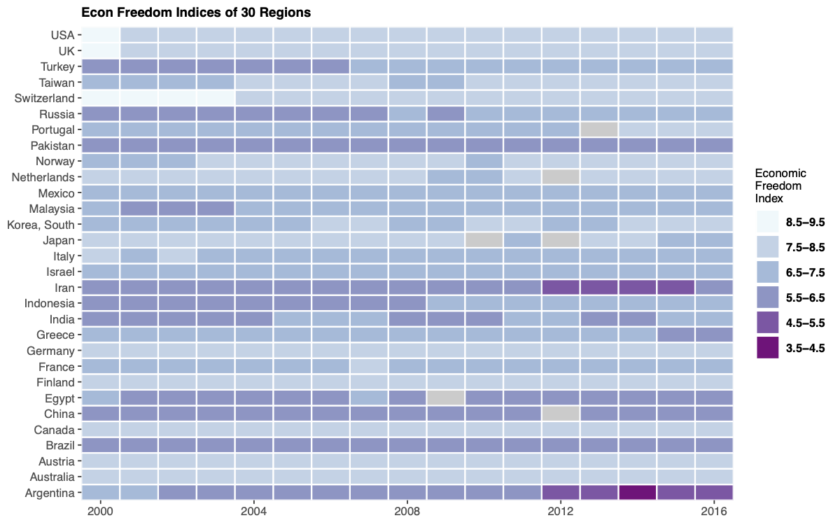
World Economic Freedom & Its Factors
Nan Tang, University of Washington Department of Statistics
What would affect Economic Freedom
Area 3: Sound Money - Inflation erodes the value of rightfully earned wages and savings. Sound money is thus essential to protect property rights
Area 4: Freedom to Trade Internationally - Freedom to exchange—in its broadest sense, buying, selling, making contracts, and so on—is essential to economic freedom, which is reduced when freedom to exchange does not ianclude businesses and individuals in other nations.
Area 5: Regulation - Governments not only use a number of tools to limit the right to exchange internationally, they may also develop onerous regulations that limit the right to exchange, gain credit, hire or work for whom you wish, or freely operate your business.
Area 1: Size of Government - As government spending, taxation, and the size of government-controlled enterprises increase, government decision-making is substituted for individual choice and economic freedom is reduced.
Area 2: Legal System and Property Rights - Protection of persons and their rightfully acquired property is a central element of both economic freedom and civil society. Indeed, it is the most important function of government.
Background Info & EDA
This analysis is based on the data of ‘2018 Index of Economic Freedom’, world’s premier measurement of economic freedom, ranking countries based on five areas,: size of government, legal structure, security of property rights, access to sound money, freedom to trade internationally, and regulation of credit.
Economic Freedom is the basic right of every individual, where every person is free to use their income, property & resources and invest according to their will, without much intervention from the Governmental Policies. This is very important for overall prosperity of the society, democracy and the fundamental right to make economic decisions.
From this set of scatter plots with fitted OLS regression, we know that government consumption has negative impact on its ranking in economic freedom. Color scales indicates another dimension of information from the same area as x-axis, darker the color, the higher score it is.
Bas on color scale, we can perceive that government consumption, freedom to own foreign currency, freedom in movement of personal capital, protection on property right and credit market regulations all have positive impact on indices of economic freedom.
Model Selection & Analysis
The dataset contains over thirty variables, and majority of them are measurable indices, i.e. continuous variables. Multicollinearity has been an issue within each area. Using BIC as criterion and applying forward and backward stepwise selection, I selected totally eleven variables and reached to a good balance between accuracy and over-fitting.
More than one-years data, I was trying to build a prediction model on all available data. The dataset is large enough to support an accurate OLS model, therefore, I fitted it with selected predictors from previous step, and tried all two-way interactions. Outcomes of OLS residuals turned out model that exclude any interactions has better fitness (adjusted R square = 0.93) than two-way interaction model.
Robustness analysis shows increasing dependence on judicial is one of the most efficient approaches to make improvement on economic freedom. While government consumption is the only factor that negatively impact the index.

